Slide 1
Rendering Architecture
of Fools Engine
Work in progress

Slide 2
9 – Integration Layer
7 – Graph Layer
6 – Resources Layer
5 – Communication Layer
3 - Representation Layer
2 - GDI Abstraction Layer
> 1 – Primitives Layer <
0 - Graphics Device Interface
4 - GDI Isolation Layer
8 – Render Layer
GDIType
Shader Data
Uniform
Texture Data
Frame Buffer Data
Primitive
Structure
Type
Type
Components
Format
Specification
Attachment Specification
Buffer Specification
Specification Builder
Shader Texture Slot
Vertex Data
Element
Layout

Slide 3
9 – Integration Layer
7 – Graph Layer
6 – Resources Layer
5 – Communication Layer
3 - Representation Layer
> 2 - GDI Abstraction Layer <
1 – Primitives Layer
0 - Graphics Device Interface
4 - GDI Isolation Layer
8 – Render Layer
Rendering Context
Shader
Texture
Vertex Buffer
Index Buffer
Uniform Buffer
Frame Buffer
Device API
Buffers

Slide 4
9 – Integration Layer
7 – Graph Layer
6 – Resources Layer
5 – Communication Layer
> 3 - Representation Layer <
2 - GDI Abstraction Layer
1 – Primitives Layer
0 - Graphics Device Interface
4 - GDI Isolation Layer
8 – Render Layer
Camera
Transform
Material
Mesh
Basic Shapes
Quad
Circle
Cube
Sphere
Coordinates

Slide 5
9 – Integration Layer
7 – Graph Layer
6 – Resources Layer
5 – Communication Layer
3 - Representation Layer
2 - GDI Abstraction Layer
1 – Primitives Layer
0 - Graphics Device Interface
> 4 - GDI Isolation Layer <
8 – Render Layer
Render Device
Render Commands
asd
asd
Asd
ads

Slide 6
9 – Integration Layer
7 – Graph Layer
6 – Resources Layer
> 5 – Communication Layer <
3 - Representation Layer
2 - GDI Abstraction Layer
1 – Primitives Layer
0 - Graphics Device Interface
4 - GDI Isolation Layer
8 – Render Layer
Asset Loader
Command Queue
Swap Chain

Slide 7
9 – Integration Layer
7 – Graph Layer
> 6 – Resources Layer <
5 – Communication Layer
3 - Representation Layer
2 - GDI Abstraction Layer
1 – Primitives Layer
0 - Graphics Device Interface
4 - GDI Isolation Layer
8 – Render Layer
Render Asset Manager
Material Library
Texture Library
Shader Library
Mesh Library

Slide 8
9 – Integration Layer
> 7 – Graph Layer <
6 – Resources Layer
5 – Communication Layer
3 - Representation Layer
2 - GDI Abstraction Layer
1 – Primitives Layer
0 - Graphics Device Interface
4 - GDI Isolation Layer
8 – Render Layer
Render Pipeline
Render Pass

Slide 9
9 – Integration Layer
7 – Graph Layer
6 – Resources Layer
5 – Communication Layer
3 - Representation Layer
2 - GDI Abstraction Layer
1 – Primitives Layer
0 - Graphics Device Interface
4 - GDI Isolation Layer
> 8 – Render Layer <
Geometry Renderer
Deferred Renderer
Forward Renderer
VFX Renderer

Slide 10
> 9 – Integration Layer <
7 – Graph Layer
6 – Resources Layer
5 – Communication Layer
3 - Representation Layer
2 - GDI Abstraction Layer
1 – Primitives Layer
0 - Graphics Device Interface
4 - GDI Isolation Layer
8 – Render Layer
Render Director
Scene Renderer
UI Renderer

Slide 11
9 – Integration Layer
7 – Graph Layer
6 – Resources Layer
5 – Communication Layer
3 - Representation Layer
2 - GDI Abstraction Layer
1 – Primitives Layer
0 - Graphics Device Interface
4 - GDI Isolation Layer
8 – Render Layer
Render Director
Scene Renderer
UI Renderer
Geometry Renderer
Deferred Renderer
Forward Renderer
VFX Renderer
Render Pipeline
Render Pass
Render Asset Manager
Material Library
Texture Library
Shader Library
Mesh Library
Asset Loader
Command Queue
Swap Chain
Render Commands
Transform
Material
Mesh
Basic Shapes
Coordinates
Rendering Context
Render Device
Camera
Shader
Texture
Vertex Buffer
Index Buffer
Frame Buffer
Device API
GDIType
Shader Data
Uniform
Shader Texture Slot
Texture Data
Buffer Data
Frame Buffer Data
OpenGL
Vulkan
DirectX3D
Metal
Uniform Buffer

Slide 12
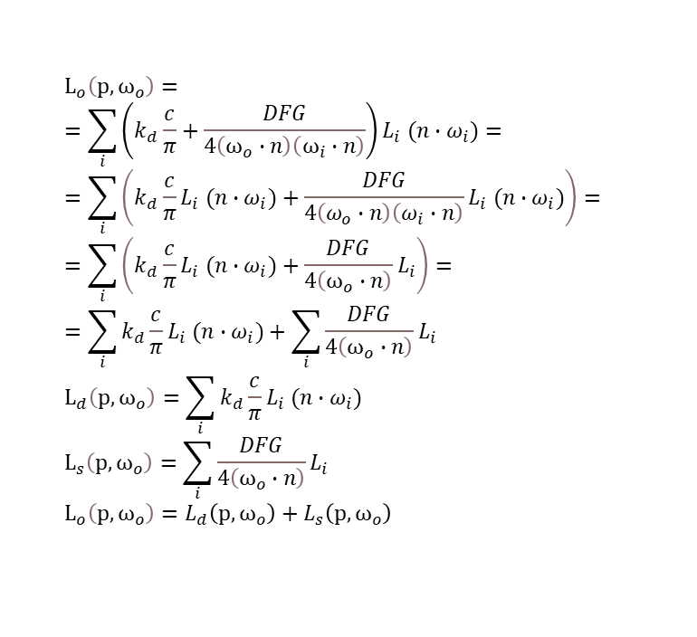
Redeferred rendering – Experimental concept
Let’s split diffused and specular contributions of the rendering equation
$$L_{o}\left(p, ω_{o}\right)= \\ =\sum_{i}{\left(k_{d}\frac{c}{π}+\frac{DFG}{4\left(ω_{o}∙n\right)\left(ω_{i}∙n\right)}\right)L_{i} (n∙ω_{i})}= \\ =\sum_{i}{\left(k_{d}\frac{c}{π}L_{i} (n∙ω_{i})+\frac{DFG}{4\left(ω_{o}∙n\right)\left(ω_{i}∙n\right)}L_{i} (n∙ω_{i})\right)}= \\ =\sum_{i}{\left(k_{d}\frac{c}{π}L_{i} (n∙ω_{i})+\frac{DFG}{4\left(ω_{o}∙n\right)}L_{i}\right)}= \\ =\sum_{i}{k_{d}\frac{c}{π}L_{i} (n∙ω_{i})}+\sum_{i}{\frac{DFG}{4\left(ω_{o}∙n\right)}L_{i}} \\ L_{d}\left(p, ω_{o}\right)=\sum_{i}{k_{d}\frac{c}{π}L_{i} (n∙ω_{i})}$$
$$L_{s}\left(p, ω_{o}\right)=\sum_{i}{\frac{DFG}{4\left(ω_{o}∙n\right)}L_{i}} \\ L_{o}\left(p, ω_{o}\right)=L_{d}\left(p, ω_{o}\right)+L_{s}\left(p, ω_{o}\right)$$
We’re going to store them in dedicated variables while calculating them in a per light loop.
Then we are going to add them back together outside the loop.

Slide 13
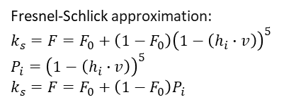
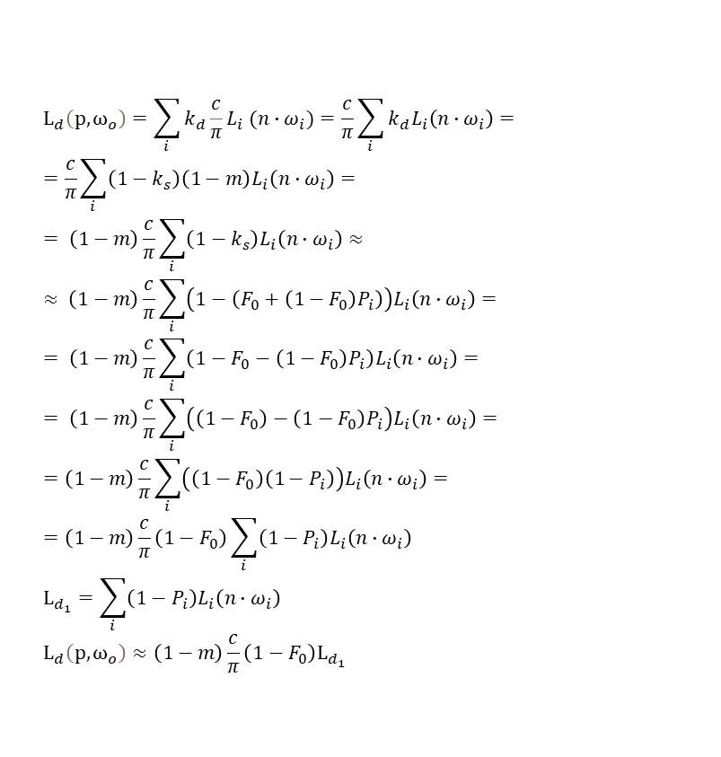
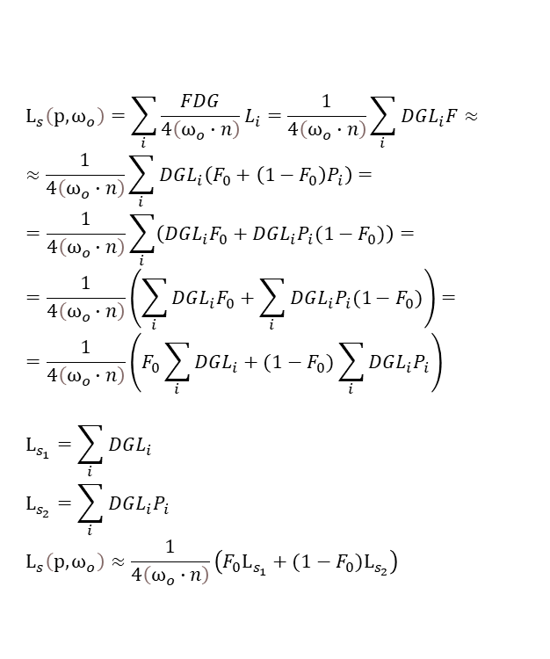
Diffused
Specular
$$L_{d}\left(p, ω_{o}\right)=\sum_{i}{k_{d}\frac{c}{π}L_{i} (n∙ω_{i})}=\frac{c}{π}\sum_{i}{{k_{d}L}_{i}\left(n∙ω_{i}\right)}= \\ =\frac{c}{π}\sum_{i}{{\left(1−k_{s}\right)\left(1−m\right)L}_{i}\left(n∙ω_{i}\right)}= \\ = \left(1−m\right)\frac{c}{π}\sum_{i}{\left(1−k_{s}\right)L_{i}\left(n∙ω_{i}\right)}≈ \\ ≈ \left(1−m\right)\frac{c}{π}\sum_{i}{\left(1−\left(F_{0}+\left(1−F_{0}\right)P_{i}\right)\right)L_{i}\left(n∙ω_{i}\right)}= \\ = \left(1−m\right)\frac{c}{π}\sum_{i}{\left(1−F_{0}−\left(1−F_{0}\right)P_{i}\right)L_{i}\left(n∙ω_{i}\right)}= \\ = \left(1−m\right)\frac{c}{π}\sum_{i}{\left(\left(1−F_{0}\right)−\left(1−F_{0}\right)P_{i}\right)L_{i}\left(n∙ω_{i}\right)}= \\ =\left(1−m\right)\frac{c}{π}\sum_{i}{\left(\left(1−F_{0}\right)\left(1−P_{i}\right)\right)L_{i}\left(n∙ω_{i}\right)}=$$
$$=\left(1−m\right)\frac{c}{π}\left(1−F_{0}\right)\sum_{i}{\left(1−P_{i}\right)L_{i}\left(n∙ω_{i}\right)}$$
$$L_{d_{1}}=\sum_{i}{\left(1−P_{i}\right)L_{i}\left(n∙ω_{i}\right)} \\ L_{d}\left(p, ω_{o}\right)≈\left(1−m\right)\frac{c}{π}\left(1−F_{0}\right)L_{d_{1}}$$
$$L_{s}\left(p, ω_{o}\right)=\sum_{i}{{\frac{FDG}{4\left(ω_{o}∙n\right)}L}_{i}}=\frac{1}{4\left(ω_{o}∙n\right)}\sum_{i}{DGL_{i}F}≈ \\ ≈\frac{1}{4\left(ω_{o}∙n\right)}\sum_{i}{DGL_{i}\left(F_{0}+\left(1−F_{0}\right)P_{i}\right)}= \\ =\frac{1}{4\left(ω_{o}∙n\right)}\sum_{i}{\left(DGL_{i}F_{0}+DGL_{i}P_{i}(1−F_{0})\right)}= \\ =\frac{1}{4\left(ω_{o}∙n\right)}\left(\sum_{i}{DGL_{i}F_{0}}+\sum_{i}{DGL_{i}P_{i}(1−F_{0})}\right)= \\ =\frac{1}{4\left(ω_{o}∙n\right)}\left(F_{0}\sum_{i}{DGL_{i}}+(1−F_{0})\sum_{i}{DGL_{i}P_{i}}\right)$$
$$L_{s_{1}}=\sum_{i}{DGL_{i}} \\ L_{s_{2}}=\sum_{i}{DGL_{i}P_{i}} \\ L_{s}\left(p, ω_{o}\right)≈\frac{1}{4\left(ω_{o}∙n\right)}\left(F_{0}L_{s_{1}}+(1−F_{0})L_{s_{2}}\right)$$
Fresnel-Schlick approximation:
$$k_{s}=F=F_{0}+\left(1−F_{0}\right){\left(1−\left(h_{i}∙v\right)\right)}^{5} \\ P_{i}={\left(1−\left(h_{i}∙v\right)\right)}^{5}$$
$$k_{s}=F=F_{0}+\left(1−F_{0}\right)P_{i}$$

Slide 14

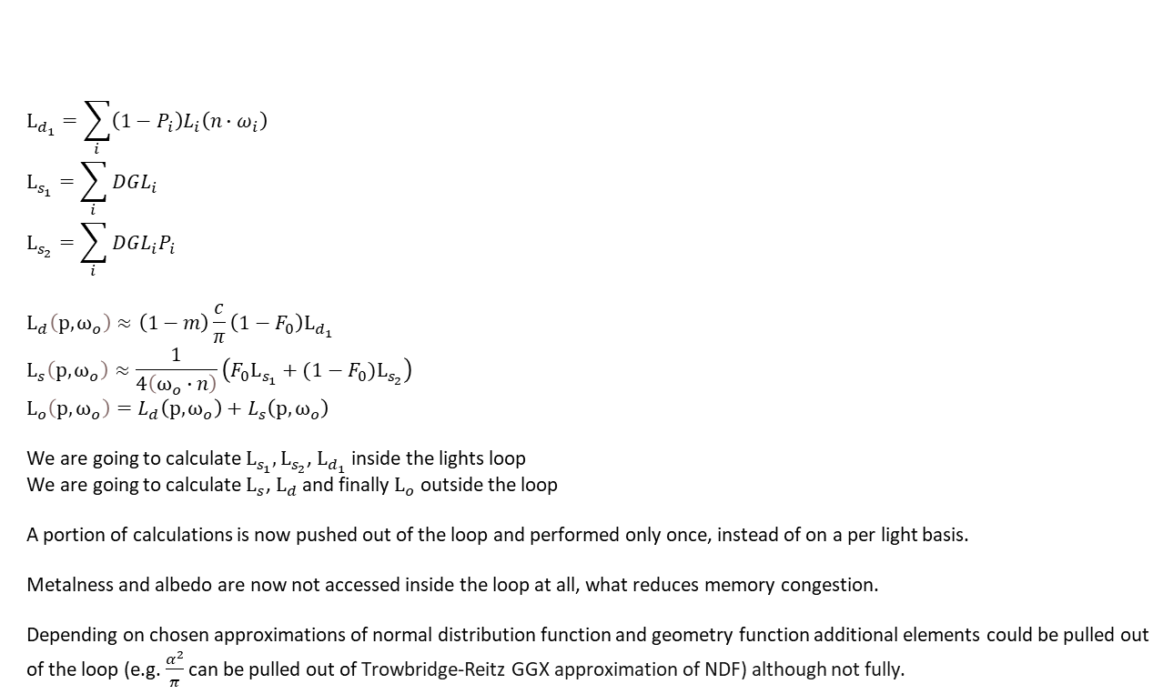
Recombination
$$L_{d_{1}}=\sum_{i}{\left(1−P_{i}\right)L_{i}\left(n∙ω_{i}\right)} \\ L_{s_{1}}=\sum_{i}{DGL_{i}} \\ L_{s_{2}}=\sum_{i}{DGL_{i}P_{i}}$$ $$L_{d}\left(p, ω_{o}\right)≈\left(1−m\right)\frac{c}{π}\left(1−F_{0}\right)L_{d_{1}} \\ L_{s}\left(p, ω_{o}\right)≈\frac{1}{4\left(ω_{o}∙n\right)}\left(F_{0}L_{s_{1}}+(1−F_{0})L_{s_{2}}\right) \\ L_{o}\left(p, ω_{o}\right)=L_{d}\left(p, ω_{o}\right)+L_{s}\left(p, ω_{o}\right)$$
We are going to calculate $L_{s_{1}}, L_{s_{2}}$, $L_{d_{1}}$ inside the lights loop
We are going to calculate $L_{s}$, $L_{d}$ and finally $L_{o}$ outside the loop
A portion of calculations is now pushed out of the loop and performed only once, instead of on a per light basis.
Metalness and albedo are now not accessed inside the loop at all, what reduces memory congestion.
Depending on chosen approximations of normal distribution function and geometry function additional elements could be pulled out of the loop (e.g. $\frac{α^{2}}{π}$ can be pulled out of Trowbridge-Reitz GGX approximation of NDF) although not fully.
$$P_{i}={\left(1−\left(h_{i}∙v\right)\right)}^{5}$$

Slide 15
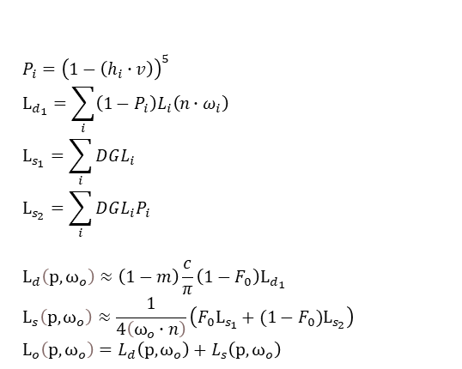
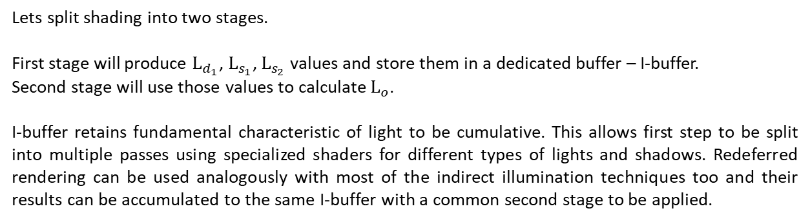
Redeffered rendering
$$P_{i}={\left(1−\left(h_{i}∙v\right)\right)}^{5}$$
$$L_{d_{1}}=\sum_{i}{\left(1−P_{i}\right)L_{i}\left(n∙ω_{i}\right)} \\ L_{s_{1}}=\sum_{i}{DGL_{i}} \\ L_{s_{2}}=\sum_{i}{DGL_{i}P_{i}}$$ $$L_{d}\left(p, ω_{o}\right)≈\left(1−m\right)\frac{c}{π}\left(1−F_{0}\right)L_{d_{1}} \\ L_{s}\left(p, ω_{o}\right)≈\frac{1}{4\left(ω_{o}∙n\right)}\left(F_{0}L_{s_{1}}+(1−F_{0})L_{s_{2}}\right) \\ L_{o}\left(p, ω_{o}\right)=L_{d}\left(p, ω_{o}\right)+L_{s}\left(p, ω_{o}\right)$$
Lets split shading into two stages.
First stage will produce $L_{d_{1}}$, $L_{s_{1}}$, $L_{s_{2}}$ values and store them in a dedicated buffer – I-buffer.
Second stage will use those values to calculate $L_{o}$.
I-buffer retains fundamental characteristic of light to be cumulative. This allows first step to be split into multiple passes using specialized shaders for different types of lights and shadows. Redeferred rendering can be used analogously with most of the indirect illumination techniques too and their results can be accumulated to the same I-buffer with a common second stage to be applied.
First stage depends only on lights and geometry (from PBR point of view roughness is a simplified representation of subpixel geometry, not a property of a substance). The variability of output buffer is expected to be low (imagine white world with colorful lights). That makes this stage a good candidate for shading rate reducing technique (lower overall resolution of the buffer / VRS / Deferred Adaptive Compute Shading / etc.). We can safely apply reduced shading rate everywhere unless there is an illumination discontinuity (hard shadow / geometry edge) from a particular illumination source – this will require visual confirmation about quality.
Second stage does not have to iterate over illumination sources, so it will be used to refine results by integrating them with materials at full resolution. It will fully cover artifacts of reduced shading rate from first pass, making them completely imperceptible. If roughness is pulled out of Trowbridge-Reitz GGX approximation of NDF, then we have all parameters of a given pixel from G-buffer taken into consideration during refining second pass.

Slide 16
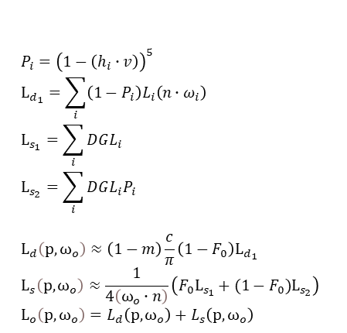
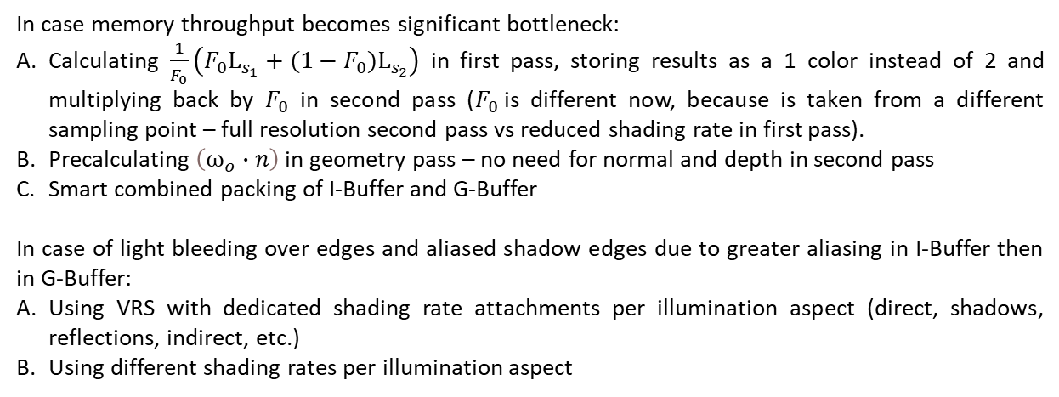
Redeffered rendering - considerations
$$P_{i}={\left(1−\left(h_{i}∙v\right)\right)}^{5}$$
$$L_{d_{1}}=\sum_{i}{\left(1−P_{i}\right)L_{i}\left(n∙ω_{i}\right)} \\ L_{s_{1}}=\sum_{i}{DGL_{i}} \\ L_{s_{2}}=\sum_{i}{DGL_{i}P_{i}}$$ $$L_{d}\left(p, ω_{o}\right)≈\left(1−m\right)\frac{c}{π}\left(1−F_{0}\right)L_{d_{1}} \\ L_{s}\left(p, ω_{o}\right)≈\frac{1}{4\left(ω_{o}∙n\right)}\left(F_{0}L_{s_{1}}+(1−F_{0})L_{s_{2}}\right) \\ L_{o}\left(p, ω_{o}\right)=L_{d}\left(p, ω_{o}\right)+L_{s}\left(p, ω_{o}\right)$$
In case memory throughput becomes significant bottleneck:
Calculating $\frac{1}{F_{0}}\left(F_{0}L_{s_{1}}+(1−F_{0})L_{s_{2}}\right)$ in first pass, storing results as a 1 color instead of 2 and multiplying back by $F_{0}$ in second pass ($F_{0}$is different now, because is taken from a different sampling point – full resolution second pass vs reduced shading rate in first pass).
Precalculating $\left(ω_{o}∙n\right)$ in geometry pass – no need for normal and depth in second pass
Smart combined packing of I-Buffer and G-Buffer
In case of light bleeding over edges and aliased shadow edges due to greater aliasing in I-Buffer then in G-Buffer:
Using VRS with dedicated shading rate attachments per illumination aspect (direct, shadows, reflections, indirect, etc.)
Using different shading rates per illumination aspect

Slide 17
Previous Frame
Final
Frame
Illumination Buffer
Geometry Buffer
Memory
Albedo
Metalness
Motion Vector
Roughness
Normal
Z-Buffer
Min-Max Hi-Z
Lights
Depth only
Pre-Pass
Geometry Pass
Indirect Diffused Pass
Shadow Maps
Deferred Lighting Composition Pass
Transparent Pass
UI Pass
Execution
Min-Max Hi-Z generation
Light Culling
Indirect Specular Pass
Direct Illumination
VFX and Custom Shader Passes
Post Processing

